Slide 1

using Excel Employee Data Analysis
STUDENT NAME : RAMYA.R
REGISTER NO :122203056
DEPARTMENT : B.COM ( CS)
COLLEGE : CHENNAI NATIONAL COLLEGE OF ARTS
AND SCIENCE, AVADI-54.

Slide 2

PROJECT TITLE
EMPLOYEE ATTENDANCE ANALYSIS
USING EXCEL

Slide 4


AGENDA
Problem Statement
Project Overview
End Users
Our Solution and Proposition
Dataset Description
Modelling Approach
Results and Discussion
Conclusion
3/21/2024 Annual Review

Slide 5

PROBLEM STATEMENT
Traditional attendance monitoring system can be time consuming and can lead to impersonation and misplacement of attendance sheets.

Slide 6

PROJECT OVERVIEW
The attendance management system keeps track of daily attendance , working hours , breaks , login and logout time.
It prevents staff’s time theft.
An attendance management system integrates all attendance devices such as smart cards , biometrics , and facial recognition devices in real time.

Slide 7
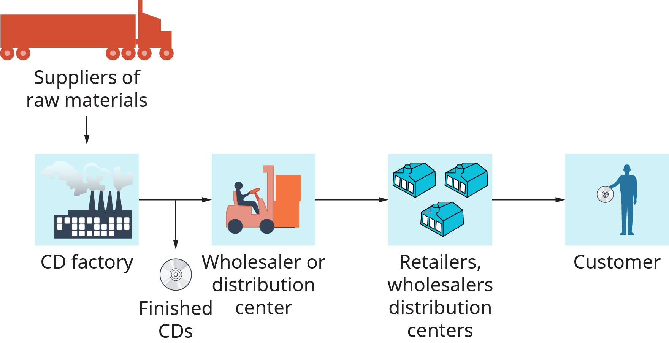

WHO ARE THE END USERS?

Slide 8

OUR SOLUTION AND ITS VALUE PROPOSITION
Pivot chart.
Formulae.
Conditional formatting.
Design.
Pie chart.

Slide 9
Dataset Description
The data refers to details on the total number of days each member signed the members attendance register in the sessions.

Slide 10

THE "WOW" IN OUR SOLUTION
In the analysis during excel I have used different formula for the calculation of sum and putting the total. And also used the conditional formatting to figure out the salary details.
3/21/2024 Annual Review
10

Slide 11
MODELLING
Pivot chart:
The pivot chart was used to explain about the employee attendance details in the diagrammatic form and also it was very easy to understand .
Conditional formatting:
The conditional formatting was used in excel for figuring out the salary on the basis of the amount of salary whichever is lesser or higher value.
Formula:
In the analysis I have used different formula that is used to calculate the salary as well as the total number of working days and the number of days the employee had worked.
Rows and columns:
The rows and the columns was mentioned by the names of the employees and their identification number and their total number of days and the number of days the employees worked and about the salary.
11

Slide 12
RESULTS
12

Slide 13
conclusion
Regular attendance is important for the employee productivity and the success of the organization.
It can help ensure that the tasks are completed on time and that projects are finishes on schedule.

